Slide 1
Introduction to Cloud Native Computing
Docker, Kubernetes, and Scalability
Connor Boyle

Slide 2
Motivating questions
What is “The Cloud” / “cloud native computing”?
How are cloud native apps different?
Which technologies support cloud native computing?
What are microservices?
Many companies are becoming “software companies”, even if they aren’t in the software business. Why?
Notes:
Have some idea what "The Cloud" is... but how do we formally define it?
What does CN computing mean? How is id different from other kinds of computing?
Talk about Docker, Kubernetes, and reference many more types of CN technologies
Patterns and Anti-patterns of the cloud

Slide 3
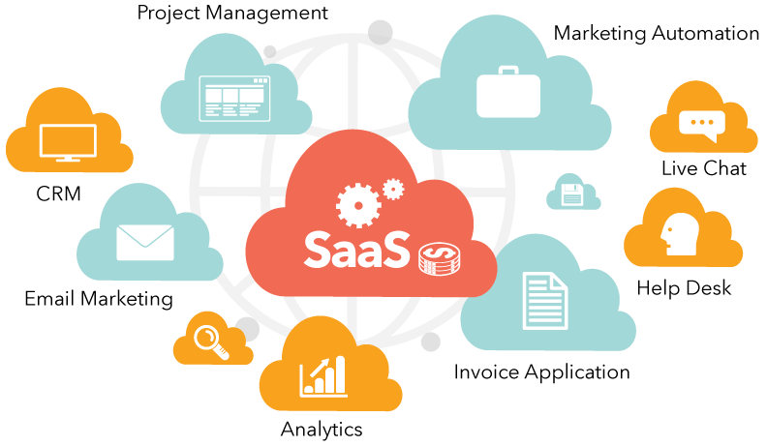
The Cloud is more than a storage platform
Remote internet services vs. local applications
Google Drive / Dropbox
Office 365
Adobe Creative Cloud
Github
SaaS – Software as a Service
Monolith vs Microservice
Notes:
single-tiered software application where the user interface and code that accesses the data are combined into a single program from a single platform.
A monolithic application is self-contained, and independent from other applications. The design philosophy is that the application is responsible not just for a particular task, but can perform every step needed to complete a particular function.

Slide 4
Essential Characteristics of the Cloud
Notes:
National Institute of Standards and Technology
On-demand self-service. A consumer can provision computing capabilities, such as server time and network storage, as needed automatically without requiring human interaction with each service provider.
Broad network access. Capabilities are available over the network and accessed through standard mechanisms that promote use by different kinds of client platforms (e.g., mobile phones, tablets, laptops, and workstations).
Resource pooling. The provider’s computing resources are pooled to serve multiple consumers using a multi-tenant model, with different physical and virtual resources dynamically assigned and reassigned according to consumer demand. There is a sense of location independence in that the customer generally has no control or knowledge over the exact location of the provided resources but may be able to specify location at a higher level of abstraction (e.g., country, state, or datacenter). Examples of resources include storage, processing, memory, and network bandwidth.
Rapid elasticity. Capabilities can be elastically provisioned and released, in some cases automatically, to scale rapidly outward and inward commensurate with demand. To the consumer, the capabilities available for provisioning often appear to be unlimited and can be appropriated in any quantity at any time.
Measured service. Cloud systems automatically control and optimize resource use by leveraging a metering capability1 at some level of abstraction appropriate to the type of service (e.g., storage, processing, bandwidth, and active user accounts). Resource usage can be monitored, controlled, and reported, providing transparency for both the provider and consumer of the utilized service.

Slide 5
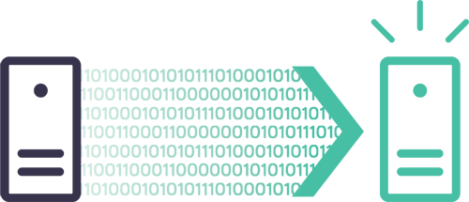
Problem 1: Dependency on Server OS

Slide 6
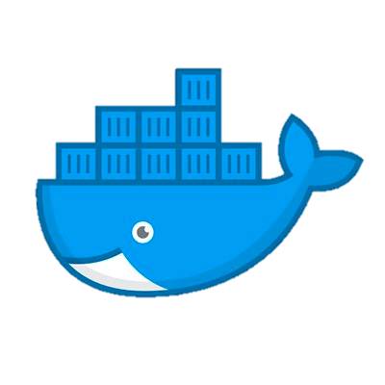
Solution 1: Virtualization

Slide 7
Problem 2: We need more resources!

Slide 8
Solution 2: Vertical Scaling
Notes:
CPU
Memory
Persistent Storage

Slide 9
Problem 3: Vertical Scaling doesn’t work
down time
maximum capacity
expensive!
Notes:
Down time
Maximum capacity
expensive

Slide 10
Solution 3: Horizontal Scaling

Slide 11
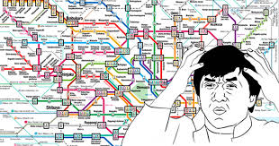
Problem 4: We can’t manage the cluster!

Slide 12
Solution 4: Container Orchestration

Slide 13

Cloud Native Computing Foundation
CN applications use an open-source software stack:
Containerized
Dynamically orchestrated
Microservices-oriented
Modern companies need cloud native computing:
allows IT and software to move faster
enables companies to create software in-house
keep up with competitors and deliver better services
enables cloud portability without vendor lock-in
Notes:
Containerized. Each part (applications, processes, etc) is packaged in its own container. This facilitates reproducibility, transparency, and resource isolation.
Dynamically orchestrated. Containers are actively scheduled and managed to optimize resource utilization.
Microservices oriented. Applications are segmented into microservices. This significantly increases the overall agility and maintainability of applications.

Slide 14
Kubernetes runs on all popular cloud providers
Notes:
enables cloud portability without vendor lock-in

Slide 15
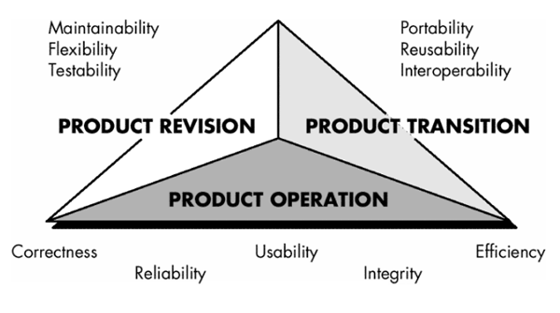
What drives people to develop CN apps?
Non-functional requirements
How should the system perform under pressure?
How easy should it be to add new features?

Slide 16
What drives people to develop CN apps?
Software process model
software agility → evolving code → need for CI/CD

Slide 17
Demo

Slide 18
Questions?

